Slide 1
BDD as a Process
Building a software that matters

Slide 2
Introduction
This is to introduce the BDD as process, where in we will be discussing about:
What is behavior driven development
Building a software that matters
Current and proposed process in Tech Refresh
Activities and outcomes of BDD
Executable specifications in BDD vocabulary
Low level specifications written as unit tests
Example of identifying the business goals
Understanding the business goals
Explore goals, capabilities and features at high level
Mapping triangle
BDD in Build Process
Three Amigos- BA, QA and Dev
What more with BDD
And finally advantages and disadvantages

Slide 3
What is Behavior Driven Development?
BDD is a second-generation, outside-in, pull based, multiple-stakeholder, multiple-scale, high-automation, agile methodology. It describes a cycle of interactions with well defined outputs, resulting in the delivery of working, tested software that matters.
Wikipedia defines Behavior Driven Development as
“In software engineering, behavior-driven development (BDD) is a software development process that emerged from test-driven development (TDD). Behavior-driven development combines the general techniques and principles of TDD with ideas from domain-driven design and object-oriented analysis and design to provide software development and management teams with shared tools and a shared process to collaborate on software development.
The tools serve to add automation to the ubiquitous language that is a central theme of BDD”

Slide 4
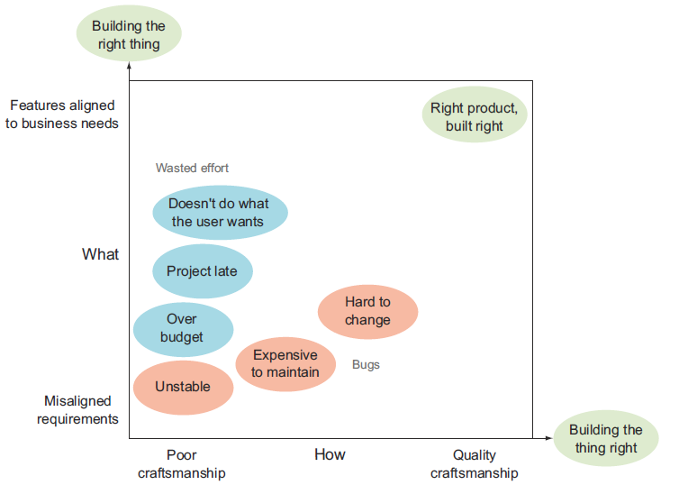
Building a software that matters

Slide 5
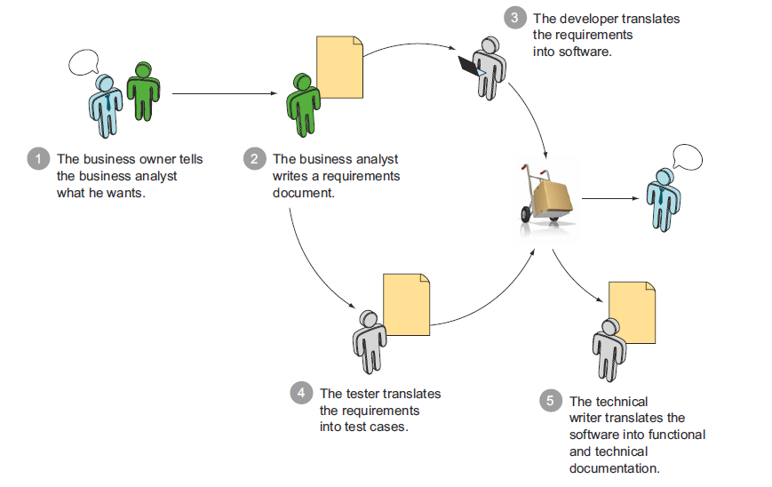
Current Process in Tech-Refresh

Slide 6
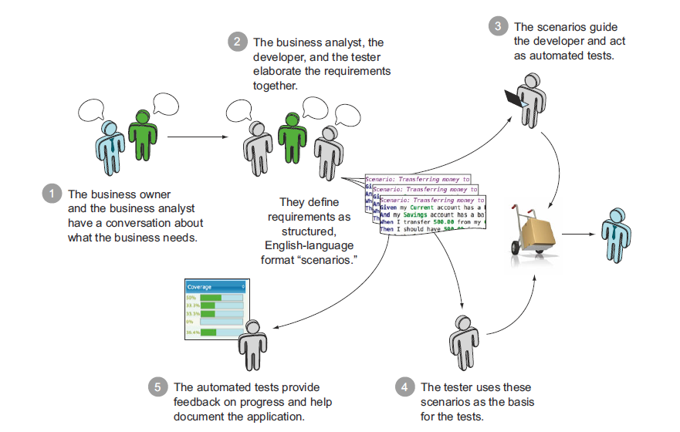
Proposed BDD Process in Tech-Refresh

Slide 7
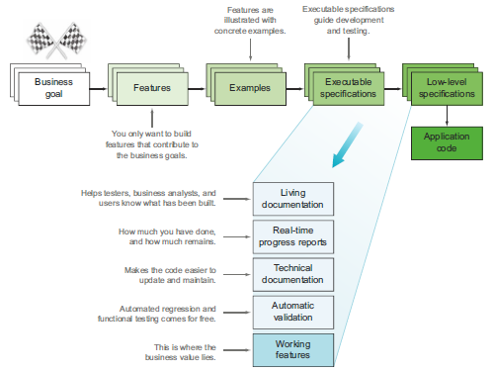
Activities and Outcomes of BDD

Slide 8
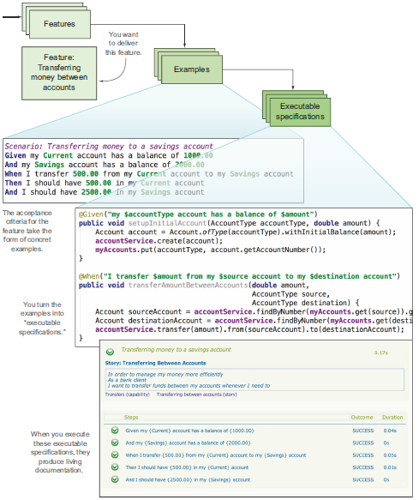
Executable specifications in business vocabulary

Slide 9
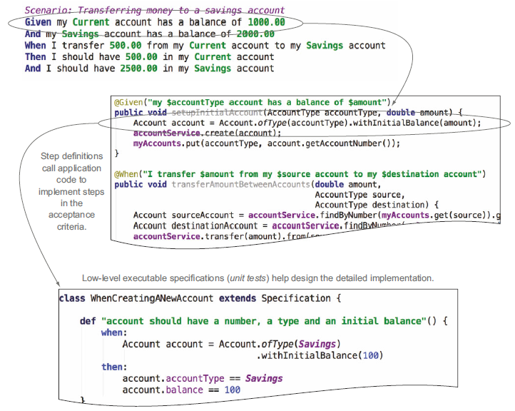
Low level specifications written as unit tests

Slide 10
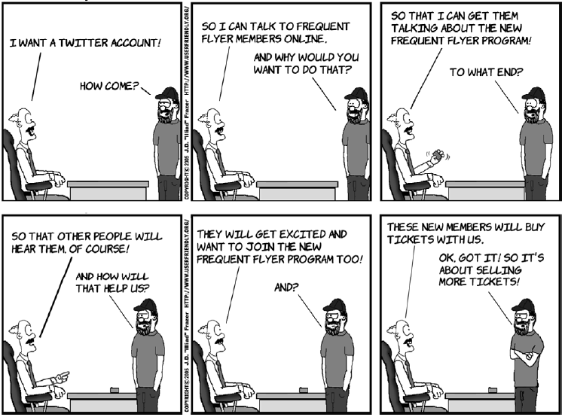
Identifying the business goals

Slide 11
Understanding the business goals
There are three strategies that can be used to understand business goals:
Feature Injection takes BDD beyond scenarios and stories and can help you discover what features you really need to satisfy the underlying business goals of a project.
Impact Mapping helps you identify and visualize the relationships between business goals, stakeholders, and features.
The Purpose-Based Alignment Model can help you judge how much effort you should put into different features.

Slide 12
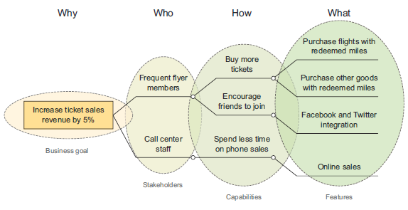
Explore goals, capabilities, features at a high level

Slide 13
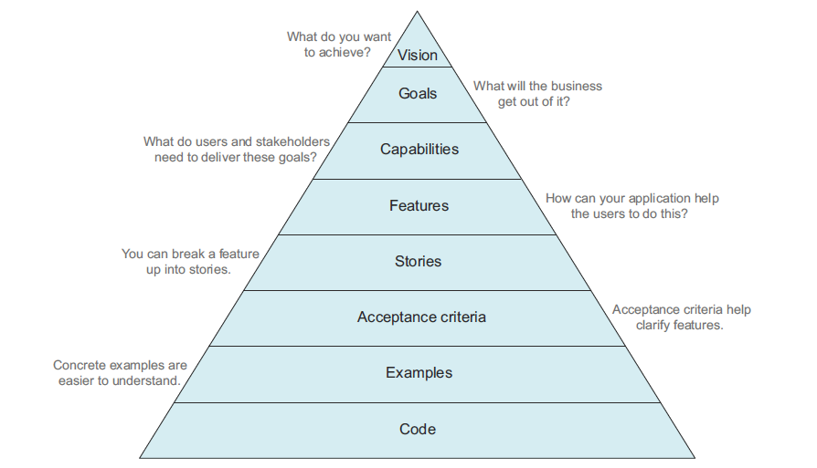
Mapping triangle
All
features,
and
ultimately
all code,
should map
back to
business goals
and the
project vision

Slide 14
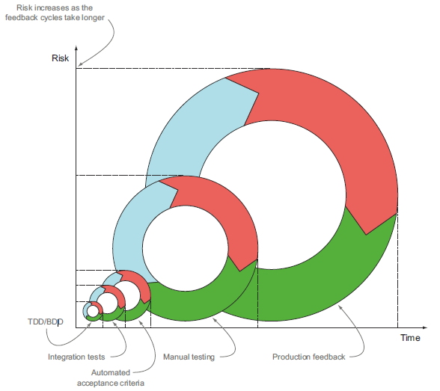
BDD in Build Process

Slide 15
Introducing the 3 Amigos
3 Amigos
Business Roles
Developer
Tester

Slide 16
Introducing the 3 Amigos
Business Roles – Product Owner or Analyst
Business value and risk evaluation domain
Their insight and input is extremely important if you want to deliver software that matters.
These people will generally ask questions like ‘is it valuable? Do we really care about this?’
Demos will be done in form of executable feature files
BA agreement on reducing the manual UAT cycle

Slide 17
Introducing the 3 Amigos
Develops
Developers talk in the same language as business does
Developers start using drop point approach within sprints
Input will give you an invaluable context into how much detail the feature should have in order to be implementable
Developers can push back business for their ideas which are not possible, or not feasibility at that moment
Developers start being developers but not only for code but also for business development and follow test first approach

Slide 18
Introducing the 3 Amigos
Testers
Usually represent the ‘problem’ space.
With test focused perspective, identify scenarios to test positive and negative behaviours
Test analysis — determining the types and structure of the test data
Focus on maintaining, updating and monitoring test pyramid
Perform error guessing and exploratory testing
Write executable acceptance criteria

Slide 19
3 AMIGOS
The core premise of BDD is not to replace these different expertise, but to move them all in one room and have a meaningful discussion about each feature before development starts. This process is called the Three Amigos or an Example Workshop and must be conducted before the team or a developer commits to deliver the feature in question.

Slide 20
What more can we do...
Continuous Business Planning: Continuously plan, measure and bring business strategy and customer feedback into development cycle. All the team members from TechRefresh/SALT should be part of business discussion meetings
Collaborative Development: Enable collaboration between business, development and QA to deliver innovative, quality software continuously.
Continuous Testing: Reduce the cost of testing while helping development teams balance quality and speed.
Continuous Release and Development: Deliver software to customers and internal users faster and more frequently with better quality, lower cost, and reduced risk.
Continuous Monitoring: Understand and accommodate the user perspective to achieve service levels with better visibility and continuous feedback across the entire software cycle
Continuous Customer Feedback and Optimization: Provide the visual evidence and full context for analyzing customer behavior and pinpointing pain points

Slide 21
Key Benefits
All development work can be traced back directly to business objectives.
Software development meets user need. Satisfied users = good business.
Efficient prioritisation - business-critical features are delivered first.
All parties have a shared understanding of the project and can be involved in the communication.
A shared language ensures everyone (technical or not) has thorough visibility into the project’s progression.
Resulting software design that matches existing and supports upcoming business needs.
Improved quality code reducing costs of maintenance and minimizing project risk.

Slide 22
Disadvantages and Potential Challenges with BDD
BDD requires high business engagement and collaboration
BDD works best in an Agile or iterative context
BDD doesn’t work well in a silo
Poorly written tests can lead to higher test-maintenance costs

Slide 23
Questions ??
Thank You
amitkumar@xebia.com
amit.kumar2@travelex.com

